Slide 1
WhiZ Search
-Harshit Shrivastava
-T.V. Vignesh
Team No 79

Slide 2
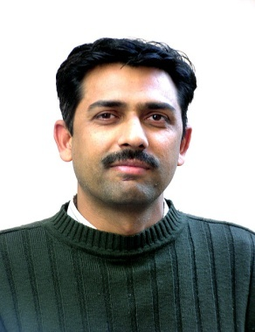
WhiZ Search
An small Instance.
Mr Rahul Kumar
1. Mr Rahul Kumar logs-on to a computer.
2. He opens Google Chrome
3. Types something, waits on the desk for about 20 mins.
4. Shuts down the computer.
5. Picks up his cheque-book, car key, cellphone etc. and leaves.

Slide 3
WhiZ Search
Let us analyse what just happened…

Slide 4

WhiZ Search
The Idea!!!
web
I want to buy a computer
Too broad search
More time consuming
WhiZ Search
Simpler interface to narrow the search to few top products
Mr Rahul Kumar

Slide 5
WhiZ Search
How it works???
A Simple Box/Frame
Mr Rahul Kumar
WhiZ Search
Google Chrome
Web

Slide 6
WhiZ Search
What next???
Mr Rahul Kumar
Uses these narrowed searched products
Goes to buy these product from the local dealers in the market
Goes to a site and orders the product online

Slide 7
WhiZ Search
Looks too simple!!!
Let us see how it worked…

Slide 8
WhiZ Search
Request in the extension window
func()
Mr Rahul Kumar
loads()
(It contains the urls)
Loads the results
Load XML

